Slide 1
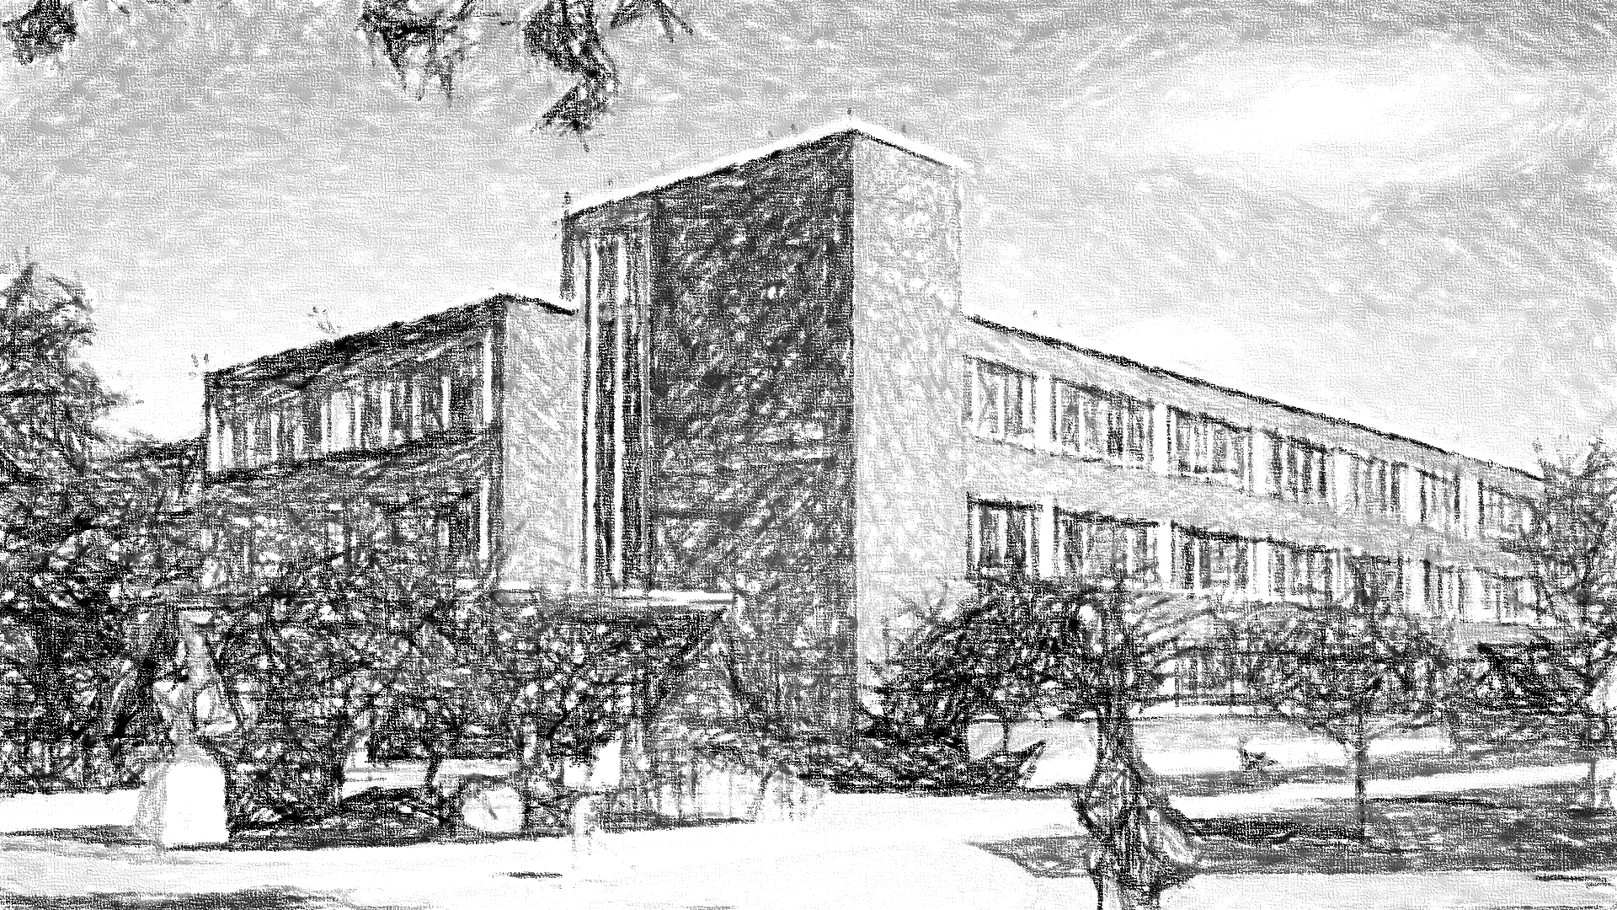
American Sign Language Object Detection
TEAM AWESOME
Chao Zhang
Jennifer Williams
Emily Murdoch

Slide 2


Syracuse University
Agenda
School of Information Studies
Business Question and Problem to Solve
Data Details
Data Preparation and Setup
Modeling
Results
Challenges
Way Ahead
Real Time Image Detection
Questions

Slide 3
Syracuse University
Business Question/Problem to Solve
School of Information Studies

Slide 4
Syracuse University
Data Details
School of Information Studies

Slide 5
Syracuse University
Data Preparation and Setup
School of Information Studies

Slide 6
Syracuse University
Modeling
School of Information Studies

Slide 7
Syracuse University
Results
School of Information Studies

Slide 8
Syracuse University
Challenges
School of Information Studies

Slide 9
Syracuse University
Way Ahead
School of Information Studies

Slide 10
Syracuse University
Questions?
School of Information Studies

